Slide 1
How does shifting the sales mix from Budweiser macrobrew beer to Elysian and other craft beers affect Anheuser-Busch’s break even sales volume?
Original blog posting (April 7, 2015)

Slide 2
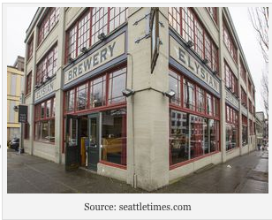
Anheuser-Busch is pursuing a strategy to more aggressively market higher-priced brands
Working to expand its sales of regional and national craft brands, including Shock Top and Goose Island
Also acquiring smaller craft beer brewers, such as Elysian Brewing Co. and 10 Barrel
The prices for a good craft beer are almost invariably higher than the prices of a mainstream macrobrew
While more costly ingredients account for some of the higher prices of craft beers, some of the higher sales price is due to marketing

Slide 3
Question 1
Assume that Anheiser Busch sales revenue remains flat during 2015, yet its profits increase. How might this be possible, given Anheiser Busch’s premiumization strategy?

Slide 4
Question 2
Assume that the Elysian beer has a higher contribution margin than Budweiser. If Anheiser Busch sells more Elysian beer due to customers switching from its Budweiser brand, what is likely to happen to Anheiser Busch’s break even sales volume? Will the replacement of the Budweiser beer sales with the Elysian beer increase or decrease the sales volume needed to achieve break even?

Slide 5
Question 3
Is the trend towards smaller craft beers a positive trend for Anheiser-Busch? Explain your reasoning.

Slide 6
Question Recap
Assume that Anheiser Busch sales revenue remains flat during 2015, yet its profits increase. How might this be possible, given Anheiser Busch’s premiumization strategy?
Assume that the Elysian beer has a higher contribution margin than Budweiser. If Anheiser Busch sells more Elysian beer due to customers switching from its Budweiser brand, what is likely to happen to Anheiser Busch’s break even sales volume? Will the replacement of the Budweiser beer sales with the Elysian beer increase or decrease the sales volume needed to achieve break even?
Is the trend towards smaller craft beers a positive trend for Anheiser-Busch? Explain your reasoning.

Slide 7
For additional news stories to use in the accounting classroom, see the Accounting in the Headlines blog at http://accountingintheheadlines.com/
Related video resources can be found at http://www.youtube.com/user/accountingheadlines
Questions or comments? Contact Dr. Wendy Tietz at wtietz@kent.edu

