Slide 1
What information is in the auditor and management letters in The J.M. Smucker Company’s Form 10-K?
Original blog posting (March 27, 2015)

Slide 2
The J.M. Smucker Company - SOURCE
http://www.jmsmucker.com/investor-relations
Then select “Corporate Reports” (online investors kit) – 2014 Annual Report

Slide 3
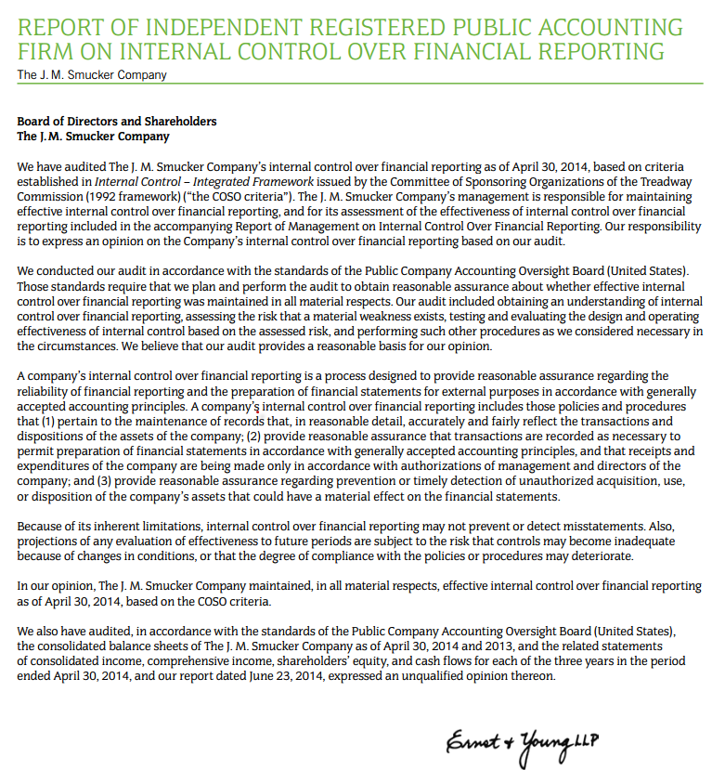

Slide 4
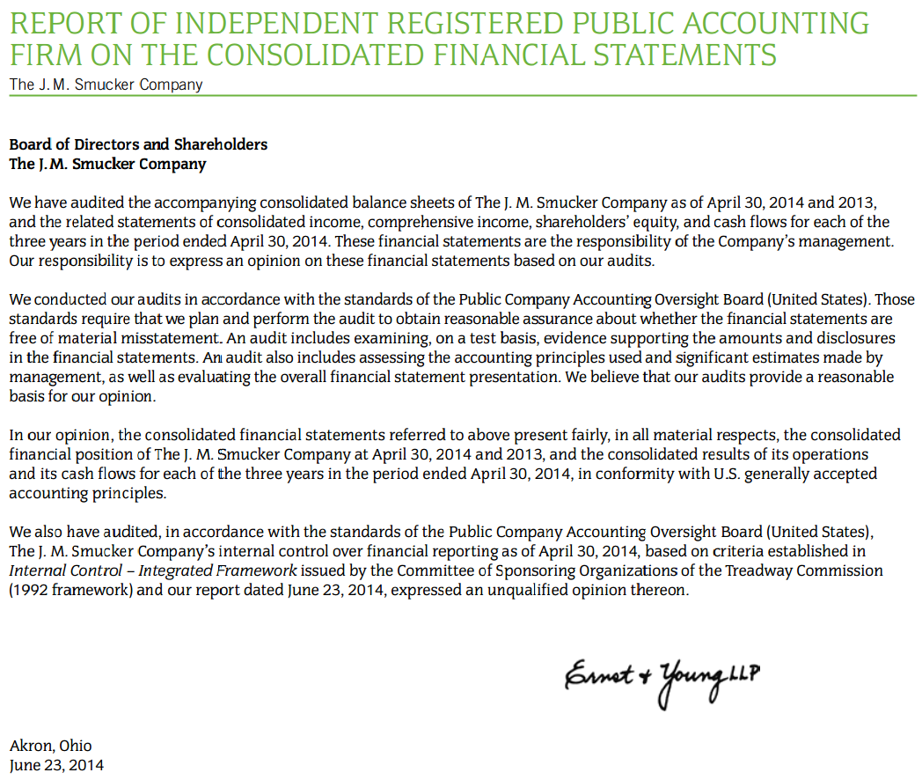
Smucker Audit Report

Slide 5
Audit report – Paragraph 1
We have audited the accompanying consolidated balance sheets of The J. M. Smucker Company as of April 30, 2014 and 2013, and the related statements of consolidated income, comprehensive income, shareholders’ equity, and cash flows for each of the three years in the period ended April 30, 2014. These financial statements are the responsibility of the Company’s management. Our responsibility is to express an opinion on these financial statements based on our audits.

Slide 6
Audit report – Paragraph 2
We conducted our audits in accordance with the standards of the Public Company Accounting Oversight Board (United States). Those standards require that we plan and perform the audit to obtain reasonable assurance about whether the financial statements are free of material misstatement. An audit includes examining, on a test basis, evidence supporting the amounts and disclosures in the financial statements. An audit also includes assessing the accounting principles used and significant estimates made by management, as well as evaluating the overall financial statement presentation. We believe that our audits provide a reasonable basis for our opinion.

Slide 7
Audit report – Paragraph 3
In our opinion, the consolidated financial statements referred to above present fairly, in all material respects, the consolidated financial position of The J. M. Smucker Company at April 30, 2014 and 2013, and the consolidated results of its operations and its cash flows for each of the three years in the period ended April 30, 2014, in conformity with U.S. generally accepted accounting principles.

Slide 8
Audit report – Paragraph 4
We also have audited, in accordance with the standards of the Public Company Accounting Oversight Board (United States), The J. M. Smucker Company’s internal control over financial reporting as of April 30, 2014, based on criteria established in Internal Control – Integrated Framework issued by the Committee of Sponsoring Organizations of the Treadway Commission (1992 framework) and our report dated June 23, 2014, expressed an unqualified opinion thereon.

Slide 9
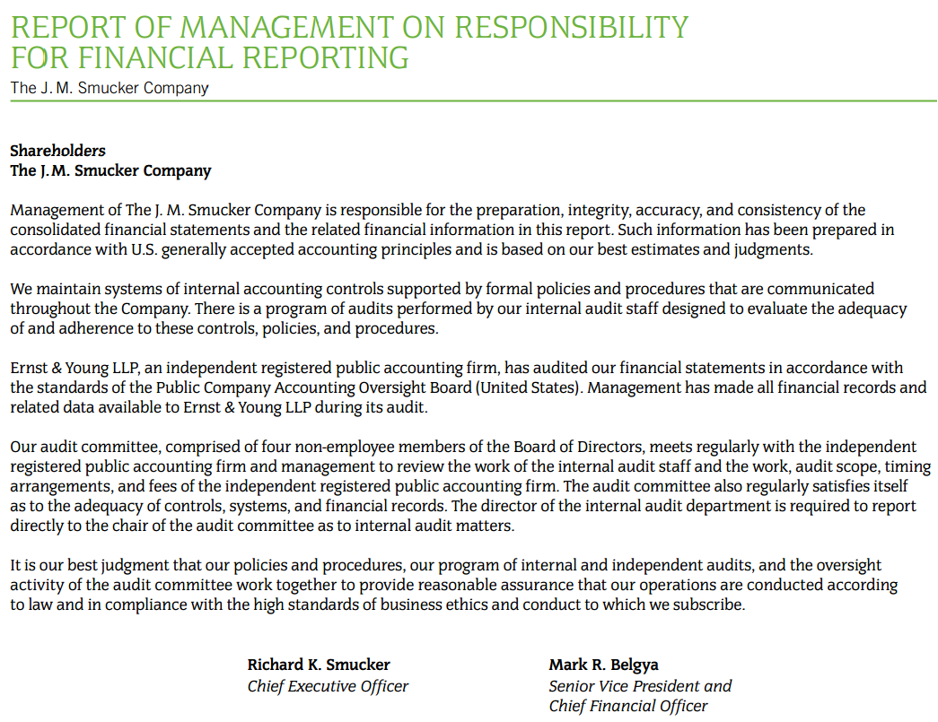
Smucker Audit Report

Slide 10
Mgmt responsibility – Paragraph 1
Management of The J. M. Smucker Company is responsible for the preparation, integrity, accuracy, and consistency of the consolidated financial statements and the related financial information in this report. Such information has been prepared in accordance with U.S. generally accepted accounting principles and is based on our best estimates and judgments.

Slide 11
Mgmt responsibility – Paragraph 2
We maintain systems of internal accounting controls supported by formal policies and procedures that are communicated throughout the Company. There is a program of audits performed by our internal audit staff designed to evaluate the adequacy of and adherence to these controls, policies, and procedures.

Slide 12
Mgmt responsibility – Paragraph 3
Ernst & Young LLP, an independent registered public accounting firm, has audited our financial statements in accordance with the standards of the Public Company Accounting Oversight Board (United States). Management has made all financial records and related data available to Ernst & Young LLP during its audit.

Slide 13
Mgmt responsibility – Paragraph 4
Our audit committee, comprised of four non-employee members of the Board of Directors, meets regularly with the independent registered public accounting firm and management to review the work of the internal audit staff and the work, audit scope, timing arrangements, and fees of the independent registered public accounting firm. The audit committee also regularly satisfies itself as to the adequacy of controls, systems, and financial records. The director of the internal audit department is required to report directly to the chair of the audit committee as to internal audit matters.

Slide 14
Mgmt responsibility – Paragraph 5
It is our best judgment that our policies and procedures, our program of internal and independent audits, and the oversight activity of the audit committee work together to provide reasonable assurance that our operations are conducted according to law and in compliance with the high standards of business ethics and conduct to which we subscribe.

Slide 15
Question 1
What is management’s responsibility related to the financial statements and related financial information in the Form 10-K?

Slide 16
Question 2
Who is Smucker’s independent audit firm? What is the auditor’s responsibility related to the financial statements and related financial information in the Form 10-K?

Slide 17
Question 3
What does an internal audit department do?

Slide 18
Question 4
Does the audit guarantee that the financial statements are completely correct? How do you know?

Slide 19
Question 5
Why is the auditor’s report important to an investor?

Slide 20
Question Recap
What is management’s responsibility related to the financial statements and related financial information in the Form 10-K?
Who is Smucker’s independent audit firm? What is the auditor’s responsibility related to the financial statements and related financial information in the Form 10-K?
What does an internal audit department do?
Does the audit guarantee that the financial statements are completely correct? How do you know?
Why is the auditor’s report important to an investor?

Slide 21
For additional news stories to use in the accounting classroom, see the Accounting in the Headlines blog at http://accountingintheheadlines.com/
Related video resources can be found at http://www.youtube.com/user/accountingheadlines
Questions or comments? Contact Dr. Wendy Tietz at wtietz@kent.edu

