Slide 1
What product costs and period costs go into McDonald’s French fries?
Original blog posting (March 6, 2015)

Slide 2
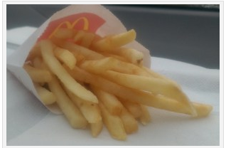
McDonald’s released a video on how its French fries are actually made
Featuring Grant Imhara, a former host from “Mythbusters”
http://youtu.be/el0EDgyO39w

Slide 3
Question 1
What is the distinction between product costs and period costs?

Slide 4
Question 2
Why is it important to sort costs into product costs and period costs?

Slide 5
Question 3
What are some product costs related to McDonald’s French fries?

Slide 6
Question 4
What are some period costs related to the manufacture and sale of McDonald’s French fries?

Slide 7
Question Recap
What is the distinction between product costs and period costs?
Why is it important to sort costs into product costs and period costs?
What are some product costs related to McDonald’s French fries?
What are some period costs related to the manufacture and sale of McDonald’s French fries?

Slide 8
For additional news stories to use in the accounting classroom, see the Accounting in the Headlines blog at http://accountingintheheadlines.com/
Related video resources can be found at http://www.youtube.com/user/accountingheadlines
Questions or comments? Contact Dr. Wendy Tietz at wtietz@kent.edu

