Slide 1
Why is Campbell Soup Company using zero-based budgeting?
Original blog posting (March 25, 2015)

Slide 2
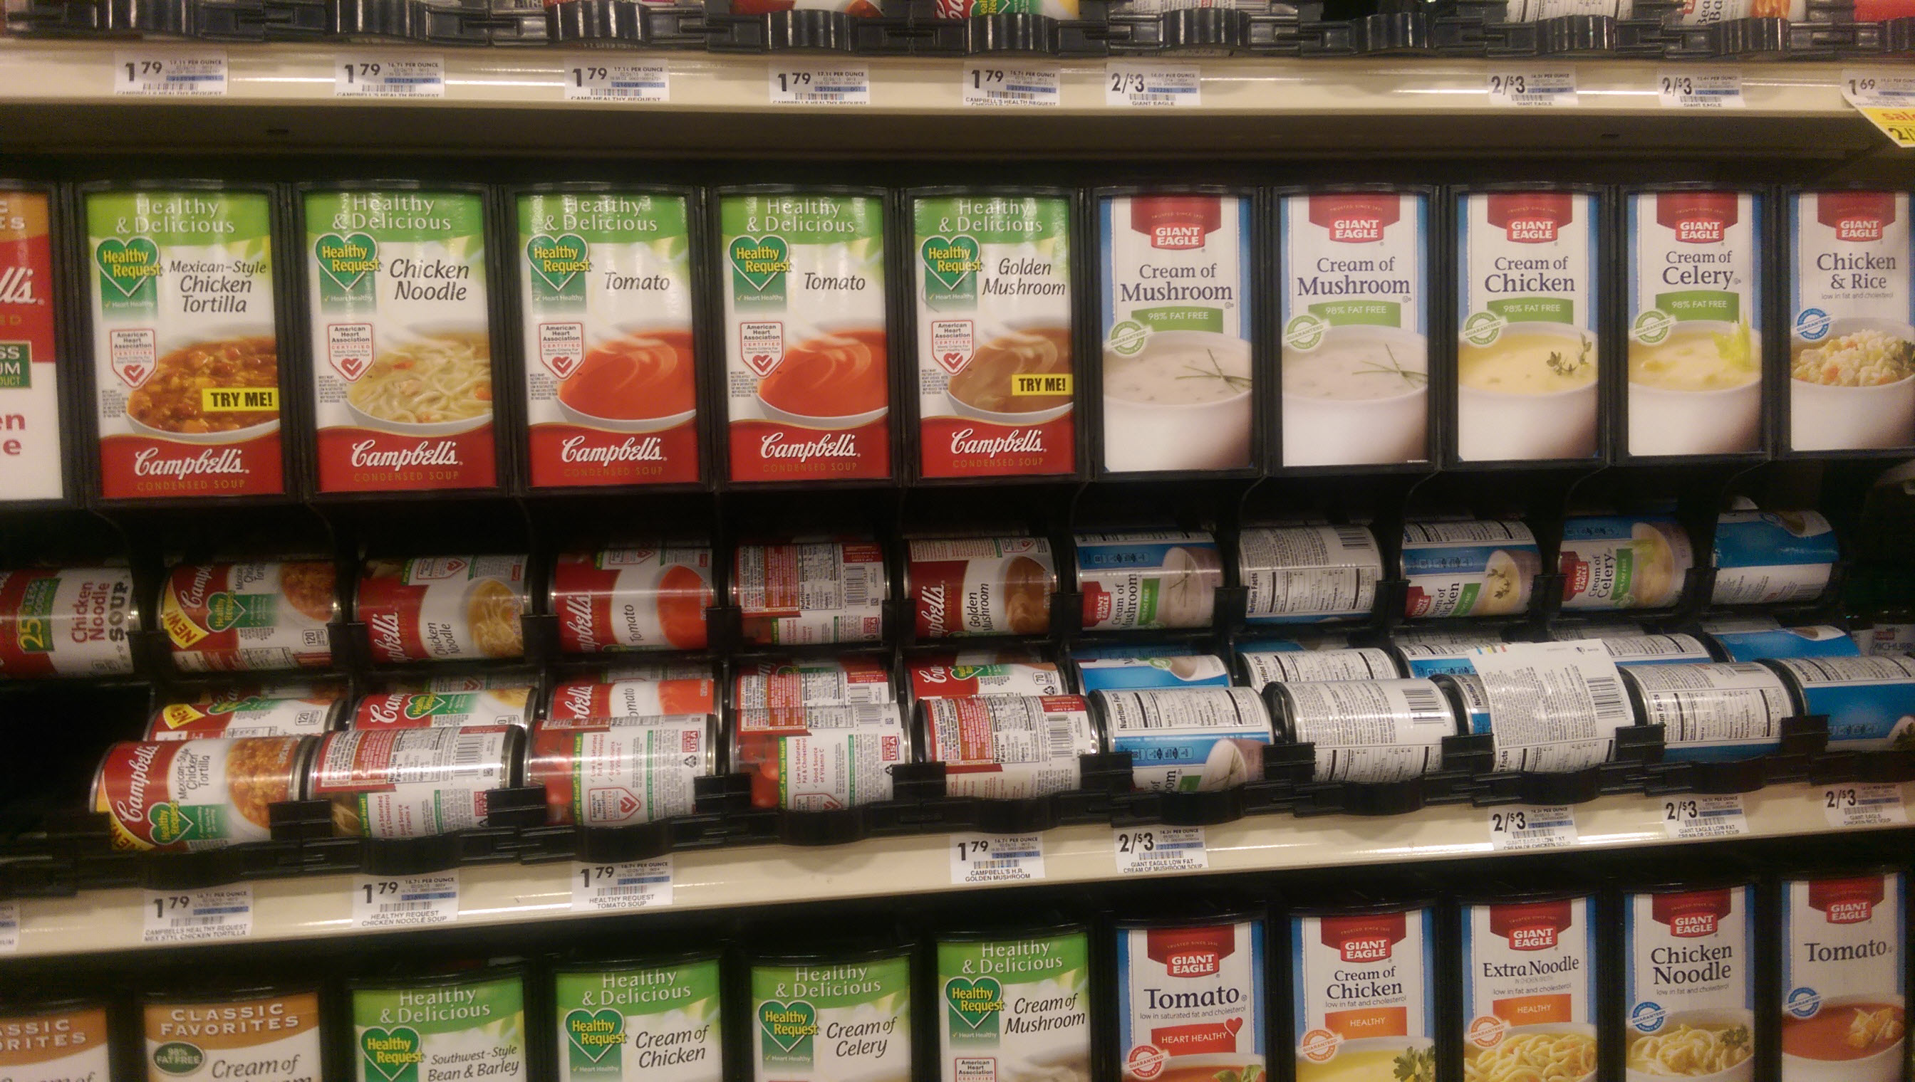
Campbell’s is working to counter effects of consumers’ increasing distrust in “Big Food”
Recently introduced a new line of organic soups, Campbell’s® Organics, and acquired both Bolthouse Farms juices and Plum Organics baby food
Announced it will be implementing zero-based budgeting
Expecting to save $200 million off expected annual costs of close to $7 billion

Slide 3
Question 1
What is “zero-based budgeting”?

Slide 4
Question 2
How does Campbell’s expect that it will save $200 million by using zero-based budgeting?

Slide 5
Question 3
What are some potential drawbacks to Campbell’s from its use of zero-based budgeting?

Slide 6
Question Recap
What is “zero-based budgeting”?
How does Campbell’s expect that it will save $200 million by using zero-based budgeting?
What are some potential drawbacks to Campbell’s from its use of zero-based budgeting?

Slide 7
For additional news stories to use in the accounting classroom, see the Accounting in the Headlines blog at http://accountingintheheadlines.com/
Related video resources can be found at http://www.youtube.com/user/accountingheadlines
Questions or comments? Contact Dr. Wendy Tietz at wtietz@kent.edu

