Slide 1
Would a Pizza Studio franchisee need to use job-costing or process costing for its made-to-order pizzas?
Original blog posting (February 20, 2015)

Slide 2
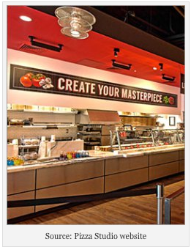
New pizza chain, Pizza Studio, takes made-to-order model used by Chipotle and Subway and applies it to pizzas
Customers can chose crust, sauce, cheese, and toppings
Pizza is baked in front of them in just two minutes
The price of each pizza is $7.99
Was founded in 2012 and has nearly 25 locations

Slide 3
Question 1
Does an individual Pizza Studio franchise operator need to decide whether to use a job-costing system or a process costing system for the pizzas it sells? Why or why not?

Slide 4
Question 2
Assume that Pizza Studio pizzas are extremely popular and Pizza Studio decides to expand into local grocery stores with frozen Pizza Studio pizzas. Do you think Pizza Studios would use more of a job-costing system or a process-costing system for the pizzas it produces for grocery stores? Explain.

Slide 5
Question Recap
Does an individual Pizza Studio franchise operator need to decide whether to use a job-costing system or a process costing system for the pizzas it sells? Why or why not?
Assume that Pizza Studio pizzas are extremely popular and Pizza Studio decides to expand into local grocery stores with frozen Pizza Studio pizzas. Do you think Pizza Studios would use more of a job-costing system or a process-costing system for the pizzas it produces for grocery stores? Explain.

Slide 6
For additional news stories to use in the accounting classroom, see the Accounting in the Headlines blog at http://accountingintheheadlines.com/
Related video resources can be found at http://www.youtube.com/user/accountingheadlines
Questions or comments? Contact Dr. Wendy Tietz at wtietz@kent.edu

