Slide 1
When does SurveyMonkey recognize revenue from its Platinum annual subscription plans?
Original blog posting (February 24, 2015)

Slide 2
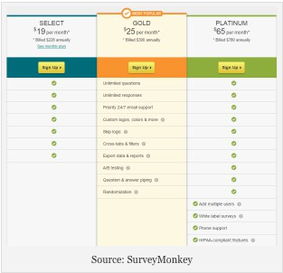
SurveyMonkey, an online service company that allows users to customize and administer surveys
Offers a free Basic plan and premium plans
One premium plan, the Platinum plan, is billed annually on the starting date of the plan and costs $780 per year

Slide 3
Question 1
Assume that Black Squirrel Design, Inc., signs up for the Platinum plan at SurveyMonkey on December 1, 2015. The customer pays the entire $780 on March 1. How will SurveyMonkey record this customer’s payment? What asset and/or liability accounts are affected?

Slide 4
Question 2
Continue the same example from Item #1. If SurveyMonkey has a December 31 year end, how much revenue related to the Platinum plan purchased by Black Squirrel Design will SurveyMonkey recognize at December 31, 2015? How much revenue from the Black Squirrel Design purchase will be recognized during 2016?

Slide 5
Question Recap
Assume that Black Squirrel Design, Inc., signs up for the Platinum plan at SurveyMonkey on December 1, 2015. The customer pays the entire $780 on March 1. How will SurveyMonkey record this customer’s payment? What asset and/or liability accounts are affected?
Continue the same example from Item #1. If SurveyMonkey has a December 31 year end, how much revenue related to the Platinum plan purchased by Black Squirrel Design will SurveyMonkey recognize at December 31, 2015? How much revenue from the Black Squirrel Design purchase will be recognized during 2016?

Slide 6
For additional news stories to use in the accounting classroom, see the Accounting in the Headlines blog at http://accountingintheheadlines.com/
Related video resources can be found at http://www.youtube.com/user/accountingheadlines
Questions or comments? Contact Dr. Wendy Tietz at wtietz@kent.edu

