Slide 1
What impact does lower fuel costs and other changes have on American Airline’s net income?
Original blog posting (January 16, 2015)

Slide 2
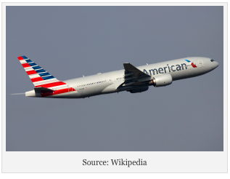
American Airlines Group has been reporting record profits in recent quarters
United Continental Holdings and Southwest Airlines also reported record profits
Price of jet fuel is down 18% since August 2014
Airfares are up 3% for 2014
Planes have been about 85% full in 2014
On the other hand, airlines spent more on fuel and labor in 2014 than in 2010

Slide 3
Question 1
Would each of the following changes INCREASE or DECREASE an airline’s net income (consider each item independently)? What income statement account would be impacted by each item?
The 3% increase in airfare (ticket prices)

Slide 4
Question 2
Would each of the following changes INCREASE or DECREASE an airline’s net income (consider each item independently)? What income statement account would be impacted by each item?
The 18% decrease in the price of per gallon of jet fuel

Slide 5
Question 3
Would each of the following changes INCREASE or DECREASE an airline’s net income (consider each item independently)? What income statement account would be impacted by each item?
The increase in the number of seats sold

Slide 6
Question 4
Would each of the following changes INCREASE or DECREASE an airline’s net income (consider each item independently)? What income statement account would be impacted by each item?
The increase in the total spent on jet fuel

Slide 7
Question 4
Would each of the following changes INCREASE or DECREASE an airline’s net income (consider each item independently)? What income statement account would be impacted by each item?
The increase in the cost of labor contracts

Slide 8
Question Recap
Would each of the following changes INCREASE or DECREASE an airline’s net income (consider each item independently)? What income statement account would be impacted by each item?
The 3% increase in airfare (ticket prices)
The 18% decrease in the price of per gallon of jet fuel
The increase in the number of seats sold
The increase in the total spent on jet fuel
The increase in the cost of labor contracts

Slide 9
For additional news stories to use in the accounting classroom, see the Accounting in the Headlines blog at http://accountingintheheadlines.com/
Related video resources can be found at http://www.youtube.com/user/accountingheadlines
Questions or comments? Contact Dr. Wendy Tietz at wtietz@kent.edu

