Slide 1
What impact does lower fuel costs and other changes have on American Airline’s breakeven point?
Original blog posting (January 7, 2015)

Slide 2
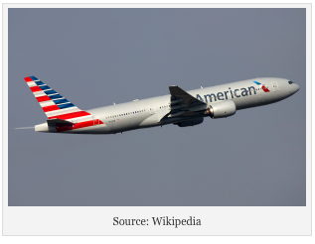
American Airlines Group has been reporting record profits in recent quarters
United Continental Holdings and Southwest Airlines also reported record profits
Price of jet fuel is down 18% since August 2014
Airfares are up 3% for 2014
Planes have been about 85% full in 2014
On the other hand, airlines spent more on fuel in 2014 than in 2010

Slide 3
Question 1
What impact would each of the following changes have on an airline’s breakeven point (consider each item independently)?
  The 3% increase in airfare (ticket prices)
  The 18% decrease in the price of per gallon of jet fuel
  The increase in the number of seats sold
  The increase in the total spent on jet fuel
  The increase in the cost of labor contracts

Slide 4
Question 2
How could the per gallon cost of jet fuel decrease yet the total cost of jet fuel increase for an airline?

Slide 5
Question 3
Is jet fuel a variable, fixed, or mixed cost for an airline?

Slide 6
Question Recap
What impact would each of the following changes have on an airline’s breakeven point (consider each item independently)?
  The 3% increase in airfare (ticket prices)
  The 18% decrease in the price of per gallon of jet fuel
  The increase in the number of seats sold
  The increase in the total spent on jet fuel
  The increase in the cost of labor contracts
How could the per gallon cost of jet fuel decrease yet the total cost of jet fuel increase for an airline?
Is jet fuel a variable, fixed, or mixed cost for an airline?

Slide 7
For additional news stories to use in the accounting classroom, see the Accounting in the Headlines blog at http://accountingintheheadlines.com/
Related video resources can be found at http://www.youtube.com/user/accountingheadlines
Questions or comments? Contact Dr. Wendy Tietz at wtietz@kent.edu

