Slide 1
How does the change in selling price impact the break even point for Amazon’s Fire Phone?
Original blog posting (November 18, 2014)

Slide 2
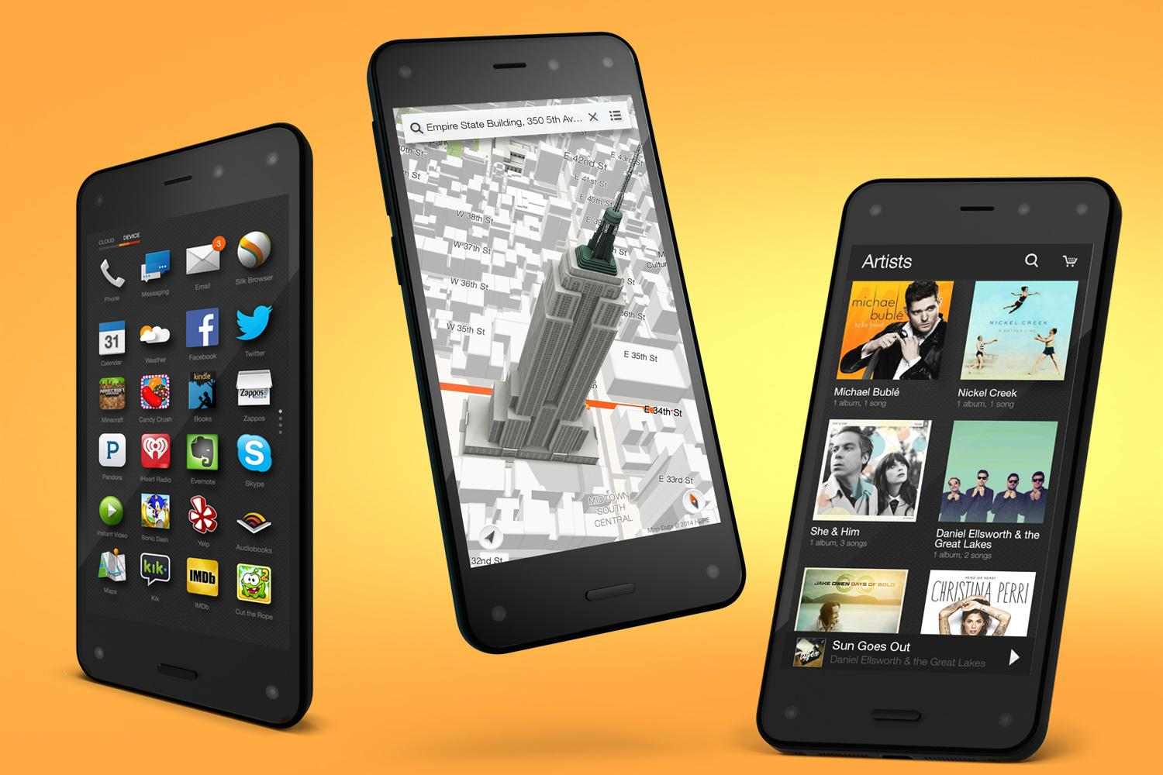
Amazon Fire Phone marked down due to lackluster sales
Relative lack of apps, sluggish performance, and short battery life
Originally offered for between $449 - $650
Now, can be purchased for $0.99 on contract
Amazon wrote down its remaining inventory of Fire phones by $83 million

Slide 3
Question 1
What range of expected contribution margins per Fire Phone did Amazon expect when it brought the Fire Phone to market in July 2014?

Slide 4
Question 2
What is the contribution margin per Fire Phone when the selling price is $0.99 per phone?

Slide 5
Question 3
Is the manufacturing cost of Fire Phones that are already in inventory relevant to the pricing of the phones? Why or why not?

Slide 6
Question 4
Generally speaking, companies would not normally want to sell products with a negative contribution margin. Why might Amazon sell phones that originally cost $205 to build for just $0.99 each?

Slide 7
Question Recap
What range of expected contribution margins per Fire Phone did Amazon expect when it brought the Fire Phone to market in July 2014?
What is the contribution margin per Fire Phone when the selling price is $0.99 per phone?
Is the manufacturing cost of Fire Phones that are already in inventory relevant to the pricing of the phones? Why or why not?
Generally speaking, companies would not normally want to sell products with a negative contribution margin. Why might Amazon sell phones that originally cost $205 to build for just $0.99 each?

Slide 8
For additional news stories to use in the accounting classroom, see the Accounting in the Headlines blog at http://accountingintheheadlines.com/
Related video resources can be found at http://www.youtube.com/user/accountingheadlines
Questions or comments? Contact Dr. Wendy Tietz at wtietz@kent.edu

