Slide 1
How did Apple’s 7-for-1 stock split affect its total stockholders’ equity?
Original blog posting (November 20, 2014)

Slide 2
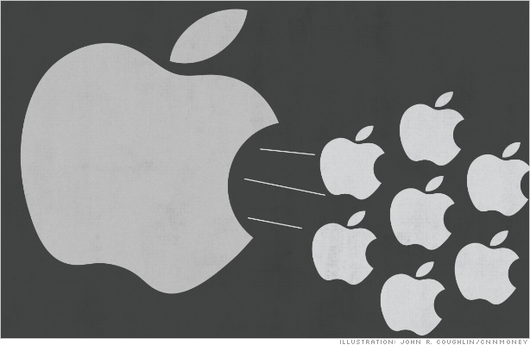
Apple, Inc. does a 7-for-1 stock split in June 2014
Before the split, Apple had 861 million shares of stock valued at roughly $650 each
After the split, Apple had approximately 6 billion shares valued at roughly $94 per share
Apple wanted to make its shares available to more investors
The current par value of Apple’s common stock is $0.00001 per share

Slide 3
Question 1
What impact does the stock split have on Apple’s total stockholders’ equity?

Slide 4
Question 2
What impact does a stock split have on a stock’s par value? Explain.

Slide 5
Question 3
Has the par value of one share of Apple stock changed since it was originally issued in 1980? Explain.

Slide 6
Question Recap
What impact does the stock split have on Apple’s total stockholders’ equity?
What impact does a stock split have on a stock’s par value? Explain.
Has the par value of one share of Apple stock changed since it was originally issued in 1980? Explain.

Slide 7
For additional news stories to use in the accounting classroom, see the Accounting in the Headlines blog at http://accountingintheheadlines.com/
Related video resources can be found at http://www.youtube.com/user/accountingheadlines
Questions or comments? Contact Dr. Wendy Tietz at wtietz@kent.edu

