Slide 1
How does Nike recognize the costs of suing 31 companies over Chuck Taylor trademark infringement?
Original blog posting (October 29, 2014)

Slide 2
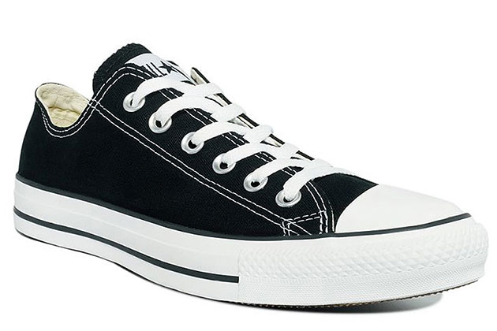
Nike Converse All-Star sneakers
October 2014, Nike filed suit against 31 companies, claiming trademark infringement for Nike’s Converse Chuck Taylor All-Star sneakers

Slide 3
History
Converse Chuck Taylor sneakers have been made since 1917
Nike purchased Converse in 2003
Shoe characteristics: black stripes and a rubber toe toppers
31 companies being sued including Walmart, Skechers, Ralph Lauren Corp, FILA, others

Slide 4
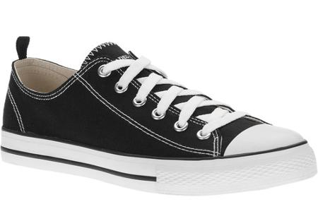
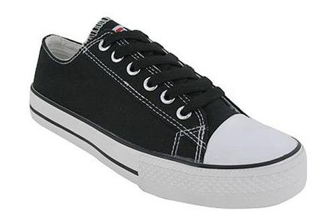
Converse
Walmart
Photo from converse.com
Photo from walmart.com
FILA
Photo from fila.com

Slide 5
Question 1
Are these bonds considered to be assets or liabilities for SolarCity? Explain.

Slide 6
Question 2
Assume that SolarCity issued the entire $200 million of Solar Bonds in one day. What would be the impact on assets? On liabilities?

Slide 7
Question 3
What is a “holder of record”?

Slide 8
Question 4
What does it mean that interest will be “paid in arrears”?

Slide 9
Question Recap
How will Nike recognize the legal costs of defending its trademark infringement? Will it expense the legal costs? Or will it capitalize the legal costs? Explain.
Do you think the outcome of the lawsuits affects whether Nike will expense or capitalize the costs? Why or why not?
If Nike does capitalize the legal costs, what type of asset is this?
Would the capitalized legal costs be depreciated or amortized over time? What condition must be met in order for these legal costs to be depreciated/amortized?

Slide 10
For additional news stories to use in the accounting classroom, see the Accounting in the Headlines blog at http://accountingintheheadlines.com/
Related video resources can be found at http://www.youtube.com/user/accountingheadlines
Questions or comments? Contact Dr. Wendy Tietz at wtietz@kent.edu

