Slide 1
How does automated technology in fast food restaurants change the cost structure, break even, and degree of operating leverage?
Original blog posting (June 18, 2014)

Slide 2
Protestors calling for higher wages at fast food restaurants
Protests occurring around the world
Wages are starting to increase

Slide 3
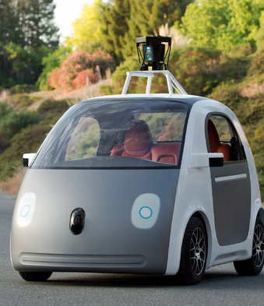
Automation occurring in fast food industry
Tablets at tableside (Applebee’s, Chili’s) to take orders and payment
Driverless cars for delivery

Slide 4
Question 1
The hourly wages of a typical fast-food worker would be considered what type of cost (fixed, variable, or mixed)?

Slide 5
Question 2
How will increased labor costs impact a restaurant’s break even point?

Slide 6
Question 3
The costs of self-service ordering kiosks or tablets would be considered what type of cost (fixed, variable, or mixed)?

Slide 7
Question 4
Would you expect a fast food restaurant’s cost structure to shift in the future due to automation to be more fixed costs or more variable costs? Why?

Slide 8
Question 5
How does this shift in cost structure due to automation impact a typical fast food restaurant’s break even point in sales dollars? Explain.

Slide 9
Question 6
How does this shift in cost structure due to automation impact a typical fast food restaurant’s degree of operating leverage? Explain.

Slide 10
Question Recap
The hourly wages of a typical fast-food worker would be considered what type of cost (fixed, variable, or mixed)?
How will increased labor costs impact a restaurant’s break even point?
The costs of self-service ordering kiosks or tablets would be considered what type of cost (fixed, variable, or mixed)?
Would you expect a fast food restaurant’s cost structure to shift in the future due to automation to be more fixed costs or more variable costs? Why?
How does this shift in cost structure due to automation impact a typical fast food restaurant’s break even point in sales dollars? Explain.
How does this shift in cost structure due to automation impact a typical fast food restaurant’s degree of operating leverage? Explain.

Slide 11
For additional news stories to use in the accounting classroom, see the Accounting in the Headlines blog at http://accountingintheheadlines.com/
Related video resources can be found at http://www.youtube.com/user/accountingheadlines
Questions or comments? Contact Dr. Wendy Tietz at wtietz@kent.edu

