Slide 1
How will cutting 18 months off the life of its Celebrex patent impact Pfizer’s profits?
Original blog posting (May 20, 2014)

Slide 2
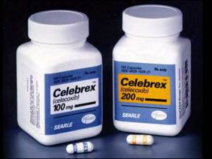
Pfizer loses exclusive right to market Celebrex earlier than it had hoped
Patent that Pfizer holds on Celebrex may expire May 30, 2014
Pfizer amortizes identifiable intangible assets using the straight-line basis over their estimated useful lives

Slide 3
Question 1
Assume that Pfizer has the Celebrex patent on its balance sheet. In what specific section of the balance sheet will this patent be included?

Slide 4
Question 2
If Pfizer’s Celebrex patent does expire on May 30, 2014, how will this impact Pfizer’s income for 2014? How will it impact Pfizer’s income for 2015?

Slide 5
Question 3
If Pfizer’s Celebrex patent does expire on May 30, 2014, how will this impact Pfizer’s balance sheet (accounting equation) for 2014? How will it impact Pfizer’s balance sheet for 2015?

Slide 6
Question Recap
Assume that Pfizer has the Celebrex patent on its balance sheet. In what specific section of the balance sheet will this patent be included?
If Pfizer’s Celebrex patent does expire on May 30, 2014, how will this impact Pfizer’s income for 2014? How will it impact Pfizer’s income for 2015?
If Pfizer’s Celebrex patent does expire on May 30, 2014, how will this impact Pfizer’s balance sheet (accounting equation) for 2014? How will it impact Pfizer’s balance sheet for 2015?

Slide 7
For additional news stories to use in the accounting classroom, see the Accounting in the Headlines blog at http://accountingintheheadlines.com/
Related video resources can be found at http://www.youtube.com/user/accountingheadlines
Questions or comments? Contact Dr. Wendy Tietz at wtietz@kent.edu

