Slide 1
How did State Street Corp. achieve cost savings from its co-working building design in Boston?
Original blog posting (April 10, 2014)

Slide 2
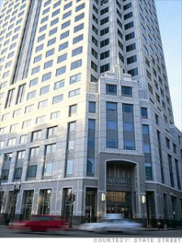
State Street Corp. designs new building with a co-working style layout
“Co-working” is a term to describe a work environment where coworkers share the same office but not necessarily the same boss
Cost per seat has decreased by 35% (from $8,500 to $5,500)
Square footage per seat has decreased by 36% (from 170 to 108 square feet)
Seat occupancy has increased to 90% (from 65%)
Annual cost per employee has decreased by 53% (from $13,000 to $6,100)

Slide 3
Question 1
List as many costs as you can think of associated with a traditional office building.

Slide 4
Question 2
Now list as many costs as you can think of associated with a co-working style office building.

Slide 5
Question 3
Which of these costs (both lists) are fixed costs with respect to the number of occupants? Which are variable costs with respect to the number of occupants?

Slide 6
Question 4
How do the costs associated with a traditional office building differ from the costs associated with a co-working style office building? How are the costs of the two types of building work design similar?

Slide 7
Question 5
How do you think that State Street Corp. achieved the cost savings from the co-working design layout?

Slide 8
Question Recap
List as many costs as you can think of associated with a traditional office building.
Now list as many costs as you can think of associated with a co-working style office building.
Which of these costs (both lists) are fixed costs with respect to the number of occupants? Which are variable costs with respect to the number of occupants?
How do the costs associated with a traditional office building differ from the costs associated with a co-working style office building? How are the costs of the two types of building work design similar?
How do you think that State Street Corp. achieved the cost savings from the co-working design layout?

Slide 9
For additional news stories to use in the accounting classroom, see the Accounting in the Headlines blog at http://accountingintheheadlines.com/
Related video resources can be found at http://www.youtube.com/user/accountingheadlines
Questions or comments? Contact Dr. Wendy Tietz at wtietz@kent.edu

