Slide 1
What is the impact of the Candy Crush Saga maker’s IPO on its balance sheet?
Original blog posting (April 2, 2014)

Slide 2
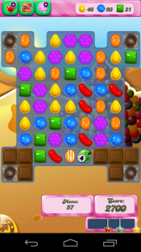
King Digital Entertainment had IPO
Began the week of March 24, 2014
Priced at $22.50 per share
Par value is $0.000197 per share
Raised about $500 million
Approximately 2,300,000 shares were issued

Slide 3
Question 1
Assume the IPO took place on March 26, 2014. What journal entry would King make on this day to reflect the stock issuance?

Slide 4
Question 2
What is the impact on assets of this IPO? On liabilities? On stockholders’ equity?

Slide 5
Question Recap
Assume the IPO took place on March 26, 2014. What journal entry would King make on this day to reflect the stock issuance?
What is the impact on assets of this IPO? On liabilities? On stockholders’ equity?

Slide 6
For additional news stories to use in the accounting classroom, see the Accounting in the Headlines blog at http://accountingintheheadlines.com/
Related video resources can be found at http://www.youtube.com/user/accountingheadlines
Questions or comments? Contact Dr. Wendy Tietz at wtietz@kent.edu

