Slide 1
How will installing tablets at all tables affect Applebee’s breakeven point?
Original blog posting (April 15, 2014)

Slide 2
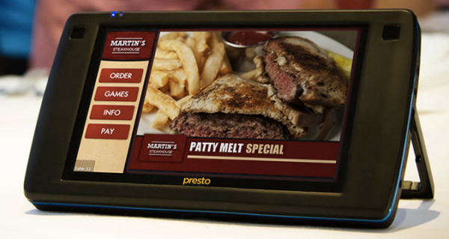
Applebee’s is installing Presto tablets by E La Carte at every table
Customers will be able to pay their food bill and order appetizers and desserts using the tablets
Also function as jukeboxes and can be used to play games

Slide 3
Question 1
Assume that, in 2014, Applebee’s does not open any new restaurants, nor does it reconfigure any of its existing restaurant layouts. Assume also that the tablet subscription fee is charged per tablet. Is the tablet subscription fee a variable cost or a fixed cost? What will be the impact of the tablet subscription fee on Applebee’s breakeven point in sales dollars? Explain.

Slide 4
Question 2
What would you expect, if any, the effect of the music and game sales revenue be on Applebee’s contribution margin ratio? Why?

Slide 5
Question Recap
Assume that, in 2014, Applebee’s does not open any new restaurants, nor does it reconfigure any of its existing restaurant layouts. Assume also that the tablet subscription fee is charged per tablet. Is the tablet subscription fee a variable cost or a fixed cost? What will be the impact of the tablet subscription fee on Applebee’s breakeven point in sales dollars? Explain.
What would you expect, if any, the effect of the music and game sales revenue be on Applebee’s contribution margin ratio? Why?

Slide 6
For additional news stories to use in the accounting classroom, see the Accounting in the Headlines blog at http://accountingintheheadlines.com/
Related video resources can be found at http://www.youtube.com/user/accountingheadlines
Questions or comments? Contact Dr. Wendy Tietz at wtietz@kent.edu

