Slide 1
What type of quality cost is involved with Toyota's Prius recall?
Original blog posting (March 31, 2014)

Slide 2
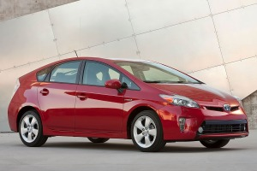
Toyota issued a recall in February 2014 for its hybrid Prius
Cars built between 2010 and 2014 were recalled globally for a software glitch in the engine control unit

Slide 3
Question 1
What type of quality costs is associated with this recall of the Toyota Prius (prevention, appraisal, internal failure, or external failure)?

Slide 4
Question 2
List the costs associated with this recall what would be (relatively) easy for Toyota to quantify (assign a dollar value to). Use your imagination.

Slide 5
Question 3
List the types of costs associated with this recall that would be difficult to quantify. Again, use your imagination.

Slide 6
Question 4
Of the costs you listed in your response to Question 2 and Question 3, which group of costs would be potentially the most devastating in terms of dollar impact? Why?

Slide 7
Question Recap
What type of quality costs is associated with this recall of the Toyota Prius (prevention, appraisal, internal failure, or external failure)?
List the costs associated with this recall what would be (relatively) easy for Toyota to quantify (assign a dollar value to). Use your imagination.
List the types of costs associated with this recall that would be difficult to quantify. Again, use your imagination.
Of the costs you listed in your response to Question 2 and Question 3, which group of costs would be potentially the most devastating in terms of dollar impact? Why?

Slide 8
For additional news stories to use in the accounting classroom, see the Accounting in the Headlines blog at http://accountingintheheadlines.com/
Related video resources can be found at http://www.youtube.com/user/accountingheadlines
Questions or comments? Contact Dr. Wendy Tietz at wtietz@kent.edu

