Slide 1
Should the original cost of the leftover 10 million pounds of Mighty Wings matter to McDonald’s decision makers?
Original blog posting (January 20, 2014)

Slide 2
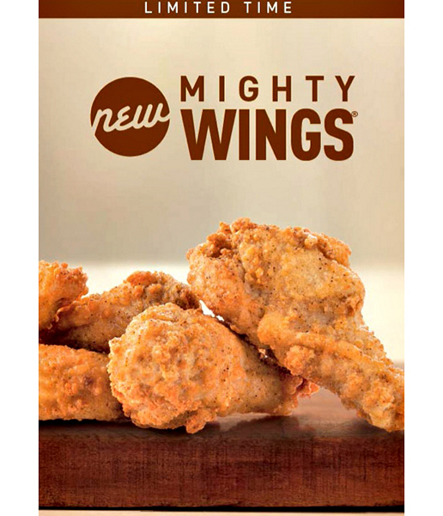
McDonald’s has a lot of leftover wings
In 1st half of 2013, McD’s stockpiled 50 million lbs of wings for its Mighty Wings menu item for fall 2013
Did not sell well due to high price
Now McD’s has 10 million lbs of wings in frozen storage

Slide 3
Question 1
Assuming that McDonald’s paid $1.20 per pound for the frozen chicken wings, what is its cost of the 10 million pounds of frozen chicken wings in inventory?

Slide 4
Question 2
The average chicken wing weighs 29 grams, which means that there are about 15 wings in a pound. What is the cost per wing in McDonald’s inventory?

Slide 5
Question 3
Should McDonald’s cost of the leftover chicken wings heavily influence what course of action McDonald’s should take to get rid of the wings? Why or why not? What type of cost is the original cost of the chicken wings?

Slide 6
Question 4
What other costs should McDonald’s consider when deciding what to do with its 10 million pounds of leftover chicken wings? Which of these other costs are fixed and which are variable?

Slide 7
Question 5
The Wall Street Journal reports that McDonald’s expects to reintroduce the Mighty Wings with new pricing of $2.99 for three wings. How much will McDonald’s make per three-wing order when comparing the sales price to its cost per chicken wing as calculated previously? Will it truly make this amount? Why or why not?

Slide 8
Question Recap
Assuming that McDonald’s paid $1.20 per pound for the frozen chicken wings, what is its cost of the 10 million pounds of frozen chicken wings in inventory?
The average chicken wing weighs 29 grams, which means that there are about 15 wings in a pound. What is the cost per wing in McDonald’s inventory?
Should McDonald’s cost of the leftover chicken wings heavily influence what course of action McDonald’s should take to get rid of the wings? Why or why not? What type of cost is the original cost of the chicken wings?
What other costs should McDonald’s consider when deciding what to do with its 10 million pounds of leftover chicken wings? Which of these other costs are fixed and which are variable?
The Wall Street Journal reports that McDonald’s expects to reintroduce the Mighty Wings with new pricing of $2.99 for three wings. How much will McDonald’s make per three-wing order when comparing the sales price to its cost per chicken wing as calculated previously? Will it truly make this amount? Why or why not?

Slide 9
For additional news stories to use in the accounting classroom, see the Accounting in the Headlines blog at http://accountingintheheadlines.com/
Related video resources can be found at http://www.youtube.com/user/accountingheadlines
Questions or comments? Contact Dr. Wendy Tietz at wtietz@kent.edu

