Slide 1
What information can be gathered from Barnes & Noble’s statement of cash flows?
Original blog posting (January 10, 2014)

Slide 2
Barnes & Noble (B & N) has eroding sales in 2012
B & N is a retailer of content, digital media, and educational products
Nearly 700 stores plus significant web presence
B & N sales are declining for both print books and e-books
Sales of the Nook have plunged
2012 Statement of Cash Flows is on next several slides

Slide 3
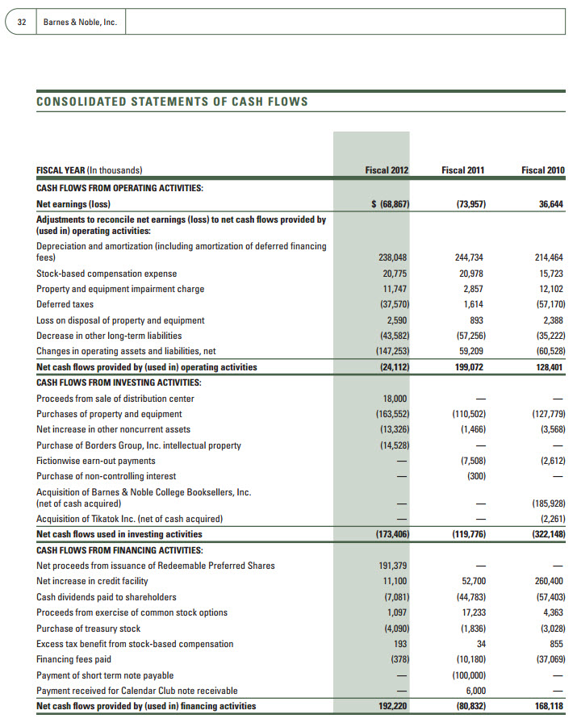

Slide 4
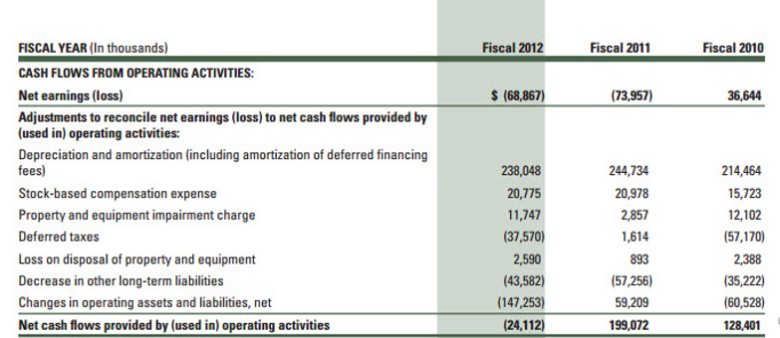

Slide 6
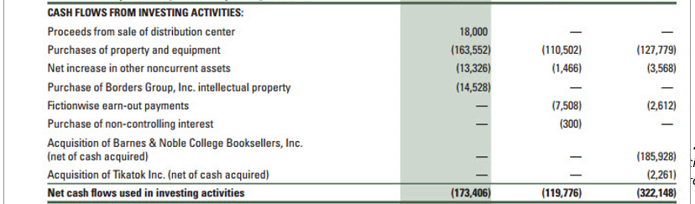

Slide 8
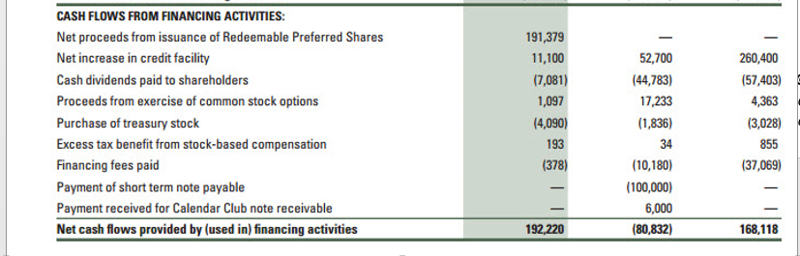

Slide 9
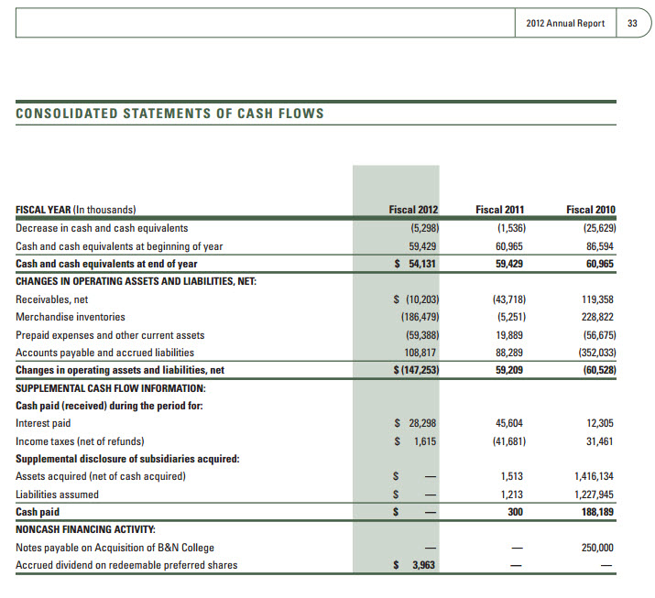

Slide 10
Question 1
Did Barnes & Noble use the indirect method or the direct method to prepare its statement of cash flows? How do you know?

Slide 11
Question 2
For fiscal 2012, did Barnes & Noble’s operating activities provide cash or use cash? How much?

Slide 12
Question 3
For fiscal 2012, did Barnes & Noble’s investing activities provide cash or use cash? How much? What investing activities used cash? What investing activities provided cash?

Slide 13
Question 4
For fiscal 2012, did Barnes & Noble’s financing activities provide cash or use cash? How much? What financing activities used cash? What financing activities provided cash?

Slide 14
Question 5
What conclusion(s) can you draw solely from Barnes & Noble’s statement of cash flows for fiscal 2012?

Slide 15
Question Recap
Did Barnes & Noble use the indirect method or the direct method to prepare its statement of cash flows? How do you know?
For fiscal 2012, did Barnes & Noble’s operating activities provide cash or use cash? How much?
For fiscal 2012, did Barnes & Noble’s investing activities provide cash or use cash? How much? What investing activities used cash? What investing activities provided cash?
For fiscal 2012, did Barnes & Noble’s financing activities provide cash or use cash? How much? What financing activities used cash? What financing activities provided cash?
What conclusion(s) can you draw solely from Barnes & Noble’s statement of cash flows for fiscal 2012?

Slide 16
For additional news stories to use in the accounting classroom, see the Accounting in the Headlines blog at http://accountingintheheadlines.com/
Related video resources can be found at http://www.youtube.com/user/accountingheadlines
Questions or comments? Contact Dr. Wendy Tietz at wtietz@kent.edu

