Slide 1
How does a stock buyback impact AutoZone's balance sheet?
Original blog posting (January 2, 2014)

Slide 2
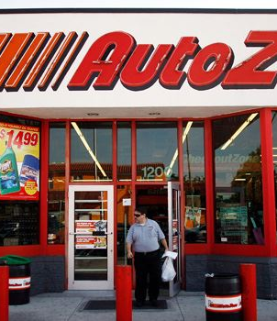
AutoZone buying back its own stock
In December 2013, Board of Directors approved an increase of $750 million in its stock buyback program

Slide 3
Question 1
On the date of the announcement that AutoZone has authorized the increase in its share buyback program, would you expect the price per share of its stock to increase or decrease? Explain.

Slide 4
Question 2
Approximately how many shares would AutoZone be able to purchase for the $750 million stock buyback program if the market price is $470 per share? (Round to the nearest whole share.)

Slide 5
Question 3
Assume that in January 2014, AutoZone’s stock trades at an average price of $470 per share. Assume also that AutoZone is able to purchase $150 million worth of its stock back and that these shares had an average price when issued of $100 per share. How many shares would it be able to purchase for the $150 million? What would the journal entry be for this stock buyback? What is the impact on assets, liabilities, and equity of this stock buyback?

Slide 6
Question 4
Now assume that AutoZone reissues these shares a year later when the market price per share is $550. The par value of one share of common stock is $0.01. What would the journal entry be for this treasury stock sale?

Slide 7
Question 5
Why might AutoZone want to buy back its stock?

Slide 8
Question Recap
On the date of the announcement that AutoZone has authorized the increase in its share buyback program, would you expect the price per share of its stock to increase or decrease? Explain.
Approximately how many shares would AutoZone be able to purchase for the $750 million stock buyback program if the market price is $470 per share? (Round to the nearest whole share.)
Assume that in January 2014, AutoZone’s stock trades at an average price of $470 per share. Assume also that AutoZone is able to purchase $150 million worth of its stock back and that these shares had an average price when issued of $100 per share. How many shares would it be able to purchase for the $150 million? What would the journal entry be for this stock buyback? What is the impact on assets, liabilities, and equity of this stock buyback?
Now assume that AutoZone reissues these shares a year later when the market price per share is $550. The par value of one share of common stock is $0.01. What would the journal entry be for this treasury stock sale?
Why might AutoZone want to buy back its stock?

Slide 9
For additional news stories to use in the accounting classroom, see the Accounting in the Headlines blog at http://accountingintheheadlines.com/
Related video resources can be found at http://www.youtube.com/user/accountingheadlines
Questions or comments? Contact Dr. Wendy Tietz at wtietz@kent.edu

