Slide 1
How does Starbucks account for gift card sales?
Original blog posting (December 23, 2013)

Slide 2
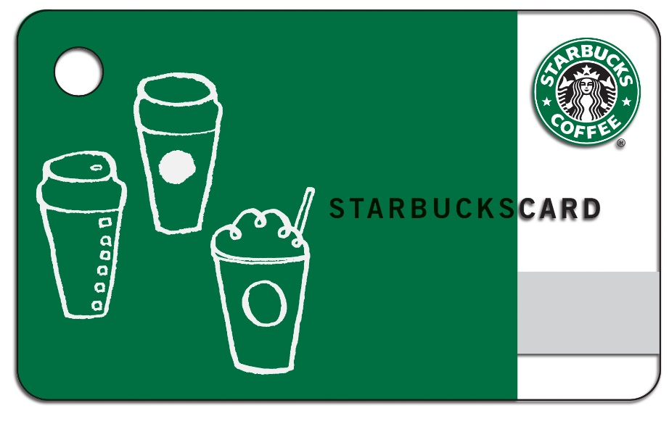
Starbucks expects to sell a record amount of gift cards in 2013
In December 2013, Starbucks was predicting record gift card sales
Gift cards have no service charge, nor do they expire

Slide 3
Question 1
Assume that Starbucks sells a total of $40,000,000 worth of gift cards on the Thursday before Christmas; half are paid for with cash and the other portion are paid for with a credit card such as VISA or MasterCard. What would the journal entry be for this transaction summary?

Slide 4
Question 2
If Starbucks sells the gift cards as described in Question 1, what is the impact on the date of sale on:
a. Assets
b. Liabilities
c. Equity

Slide 5
Question 3
When does Starbucks recognize revenue from the sale of the gift cards?

Slide 6
Question 4
Assume that VISA and MasterCard charge Starbucks a credit card fee of 1.75% plus $0.10 per transaction. How much will Starbucks incur in credit card fees on the Thursday before Christmas if its customers purchase $20,000,000 of gift cards using VISA and MasterCard? Why would Starbucks sell a gift card for just $25 when it costs Starbucks the $25 plus the credit card fees? Does the credit card fees mean that Starbucks loses money every time a customer purchases a gift card? Explain.

Slide 7
Question Recap
Assume that Starbucks sells a total of $40,000,000 worth of gift cards on the Thursday before Christmas; half are paid for with cash and the other portion are paid for with a credit card such as VISA or MasterCard. What would the journal entry be for this transaction summary?
If Starbucks sells the gift cards as described in Question 1, what is the impact on the date of sale on:
a. Assets
b. Liabilities
c. Equity
When does Starbucks recognize revenue from the sale of the gift cards?
Assume that VISA and MasterCard charge Starbucks a credit card fee of 1.75% plus $0.10 per transaction. How much will Starbucks incur in credit card fees on the Thursday before Christmas if its customers purchase $20,000,000 of gift cards using VISA and MasterCard? Why would Starbucks sell a gift card for just $25 when it costs Starbucks the $25 plus the credit card fees? Does the credit card fees mean that Starbucks loses money every time a customer purchases a gift card? Explain.

Slide 8
For additional news stories to use in the accounting classroom, see the Accounting in the Headlines blog at http://accountingintheheadlines.com/
Related video resources can be found at http://www.youtube.com/user/accountingheadlines
Questions or comments? Contact Dr. Wendy Tietz at wtietz@kent.edu

