Slide 1
How is the redemption of preferred stock reported on the statement of cash flows for Seacoast Banking Corporation of Florida?
Original blog posting (December 6, 2013)

Slide 2
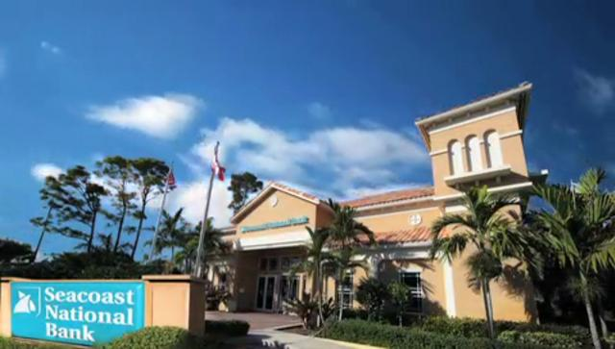
Seacoast National Bank issues notice to redeem Preferred Stock
2,000 shares of Fixed Rate Cumulative Perpetual Preferred Stock, Series A for an aggregate price of $50,000,000, the face liquidation amount of the shares, plus approximately $386,000 of accrued but unpaid dividends

Slide 3
Question 1
How will the redemption of the preferred stock be classified on Seacoast’s statement of cash flows (operating, investing, or financing activity)?

Slide 4
Question 2
Will the redemption be a “cash provided by” activity or a “cash used by” activity for Seacoast?

Slide 5
Question Recap
How will the redemption of the preferred stock be classified on Seacoast’s statement of cash flows (operating, investing, or financing activity)?
Will the redemption be a “cash provided by” activity or a “cash used by” activity for Seacoast?

Slide 6
For additional news stories to use in the accounting classroom, see the Accounting in the Headlines blog at http://accountingintheheadlines.com/
Related video resources can be found at http://www.youtube.com/user/accountingheadlines
Questions or comments? Contact Dr. Wendy Tietz at wtietz@kent.edu

