Slide 1
Should Apple Country Orchards sell Granny Smith apples or make cider from those apples?
Original blog posting (December 3, 2013)

Slide 2
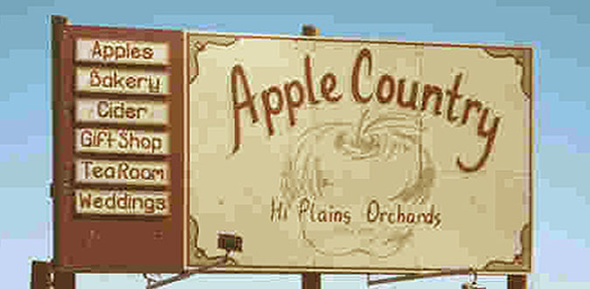
Apple Country Orchards makes cider from several different apple varieties
Granny Smith apples are known for its ability to be easily preserved in storage for up to a year and for its high antioxidant activity
Granny Smith apples are sold for $0.90 per pound
One gallon of fresh-pressed cider (about 8 pounds of apples) sells for $8

Slide 3
Question 1
Do you need to know the cost per pound that Apple Country Orchards uses for its Granny Smith apples to be able to decide if the Granny Smith apples should be sold as is (as raw apples) or processed further into cider, pie, turnovers, or any other apple product? Why or why not?

Slide 4
Question 2
From a purely quantitative standpoint, should Apple Country Orchards sell raw Granny Smith apples or process those apples further into apple cider? Support your answer with calculations.

Slide 5
Question 3
Assume that it is financially advantageous to sell raw apples rather than process them further into cider. What qualitative factors might influence Apple Country Orchards’ decision to offer fresh-pressed cider?

Slide 6
Question Recap
Do you need to know the cost per pound that Apple Country Orchards uses for its Granny Smith apples to be able to decide if the Granny Smith apples should be sold as is (as raw apples) or processed further into cider, pie, turnovers, or any other apple product? Why or why not?
From a purely quantitative standpoint, should Apple Country Orchards sell raw Granny Smith apples or process those apples further into apple cider? Support your answer with calculations.
Assume that it is financially advantageous to sell raw apples rather than process them further into cider. What qualitative factors might influence Apple Country Orchards’ decision to offer fresh-pressed cider?

Slide 7
For additional news stories to use in the accounting classroom, see the Accounting in the Headlines blog at http://accountingintheheadlines.com/
Related video resources can be found at http://www.youtube.com/user/accountingheadlines
Questions or comments? Contact Dr. Wendy Tietz at wtietz@kent.edu

