Slide 1
Should the town of Allentown, PA, outsource its pension check-writing?
Original blog posting (December 30, 2013)

Slide 2

Only one clerk knows how to use pension check-writing system
Older accounting system installed in 1983
Only one clerk has been trained on older system

Slide 3
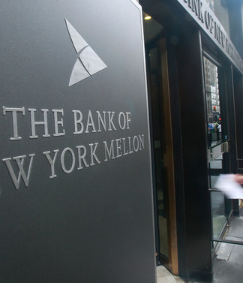
Bank of New York Mellon offers pension check-writing service
Bank of New York Mellon offers a pension check-writing service
City officials want to move pension check-writing to Bank of New York Mellon for backup and efficiency

Slide 4
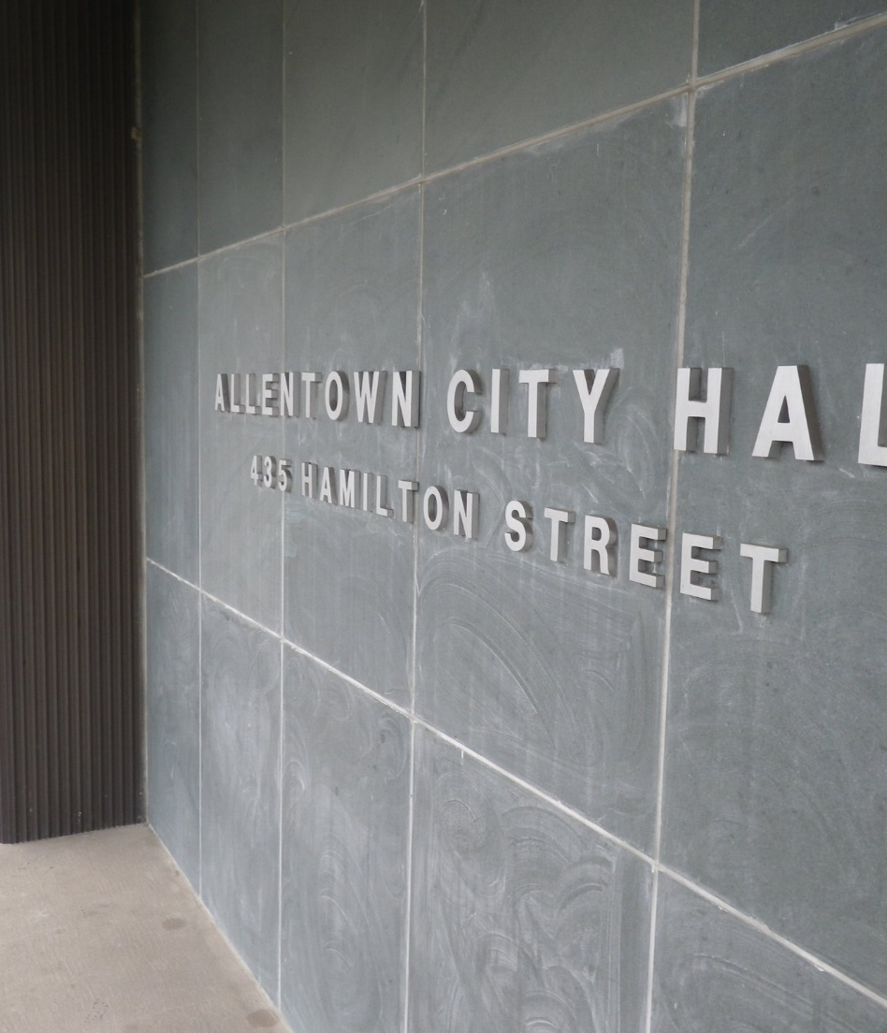
More expensive to outsource checks; police and fire unions oppose
Police and fire unions oppose the move because it would be more expensive than current method
Less cost for once-a-month checks but unions want checks every two weeks

Slide 5
Question 1
What are the advantages to processing the pension checks in-house by the payroll clerk?

Slide 6
Question 2
What are the advantages to outsourcing the pension check-writing to the Bank of New York Mellon?

Slide 7
Question 3
What are the probable types of costs of processing the pension checks by the Allentown payroll clerk? Are these costs fixed costs or variable costs? How should each of these costs be treated when comparing the cost of processing pension checks in-house to the cost of processing pension checks by an outside bank?

Slide 8
Question 4
Suppose Allentown decides to continue to process the checks in-house. What would need to be done to the current process to make it more efficient and to reduce the possibility of system failure?

Slide 9
Question Recap
What are the advantages to processing the pension checks in-house by the payroll clerk?
What are the advantages to outsourcing the pension check-writing to the Bank of New York Mellon?
What are the probable types of costs of processing the pension checks by the Allentown payroll clerk? Are these costs fixed costs or variable costs? How should each of these costs be treated when comparing the cost of processing pension checks in-house to the cost of processing pension checks by an outside bank?
Suppose Allentown decides to continue to process the checks in-house. What would need to be done to the current process to make it more efficient and to reduce the possibility of system failure?

Slide 10
For additional news stories to use in the accounting classroom, see the Accounting in the Headlines blog at http://accountingintheheadlines.com/
Related video resources can be found at http://www.youtube.com/user/accountingheadlines
Questions or comments? Contact Dr. Wendy Tietz at wtietz@kent.edu

