Slide 1
What is in Urban Outfitters’ auditor’s report?
Original blog posting (November 29, 2013)

Slide 2
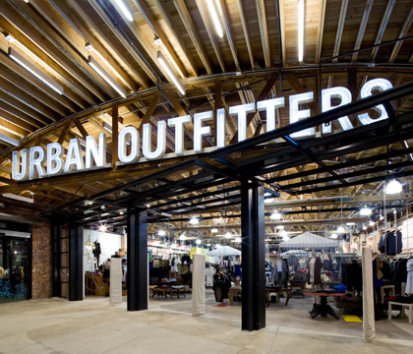
Urban Outfitters, Inc., a specialty retailer
Offers a wide selection of clothing, accessories, and other items

Slide 3
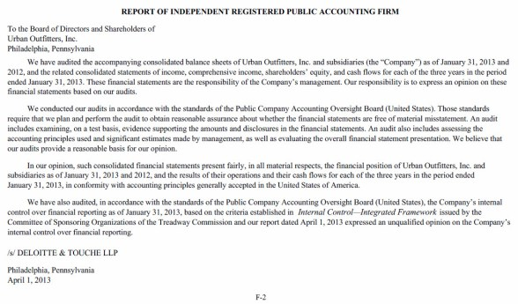

Slide 4
Question 1
What is the name of the accounting firm that audited Urban Outfitters, Inc.?

Slide 5
Question 2
What is the date of the audit report?

Slide 6
Question 3
To whom is the audit report addressed?

Slide 7
Question 4
What type of opinion did the accounting firm issue for Urban Outfitters (standard unqualified opinion, qualified opinion, adverse opinion, or disclaimer of opinion)? How do you know?

Slide 8
Question 5
What standards were used to conduct the audit?

Slide 9
Question 6
What is Urban Outfitters’ fiscal year end?

Slide 10
Question 7
What financial statements were audited?

Slide 11
Question Recap
What is the name of the accounting firm that audited Urban Outfitters, Inc.?
What is the date of the audit report?
To whom is the audit report addressed?
What type of opinion did the accounting firm issue for Urban Outfitters (standard unqualified opinion, qualified opinion, adverse opinion, or disclaimer of opinion)? How do you know?
What standards were used to conduct the audit?
What is Urban Outfitters’ fiscal year end?
What financial statements were audited?

Slide 12
For additional news stories to use in the accounting classroom, see the Accounting in the Headlines blog at http://accountingintheheadlines.com/
Related video resources can be found at http://www.youtube.com/user/accountingheadlines
Questions or comments? Contact Dr. Wendy Tietz at wtietz@kent.edu

