Slide 1
How do the added costs to produce BK’s new lower-calorie fries affect the fry breakeven point?
Original blog posting (November 4, 2013)

Slide 2
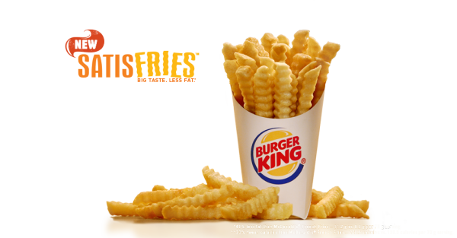
BK has a new kind of French fries
Made with a batter less porous than regular batter and absorbs less oil
Consumers pay about $0.30 more per order of Satisfries than regular fries
BK’s cost of Satisfries is similar to its regular fries cost
Satisfries

Slide 3
Question 1
What variable costs may be incurred in the process of making and selling Satisfries at Burger King?

Slide 4
Question 2
What fixed costs may have been incurred by Burger King in the development of Satisfries?

Slide 5
Question 3
What fixed costs may be incurred in the process of making and selling Satisfries at Burger King?

Slide 6
Question 4
Based on your thoughts about the variable and fixed costs structure related to Satisfries, would you expect the breakeven point of Satisfries to be higher or lower than that of Burger King’s regular fries?

Slide 7
Question Recap
What variable costs may be incurred in the process of making and selling Satisfries at Burger King?
What fixed costs may have been incurred by Burger King in the development of Satisfries?
What fixed costs may be incurred in the process of making and selling Satisfries at Burger King?
Based on your thoughts about the variable and fixed costs structure related to Satisfries, would you expect the breakeven point of Satisfries to be higher or lower than that of Burger King’s regular fries? (Note that you must make several assumptions to answer this question; you will not be able to answer it with 100% certainty because of the proprietary nature of the cost structure at Burger King.)

Slide 8
For additional news stories to use in the accounting classroom, see the Accounting in the Headlines blog at http://accountingintheheadlines.com/
Related video resources can be found at http://www.youtube.com/user/accountingheadlines
Questions or comments? Contact Dr. Wendy Tietz at wtietz@kent.edu

