Slide 1
What are potential cost drivers for an ABC system at Virgin America?
Original blog posting (September 20, 2013)

Slide 2
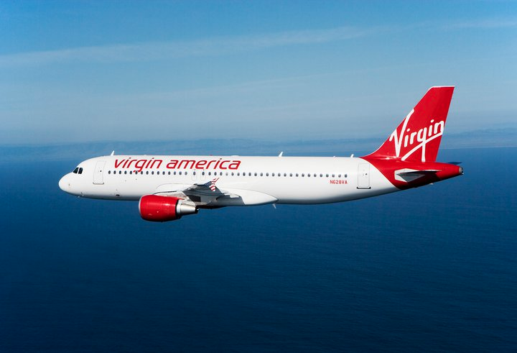
Virgin America recently announced that it anticipates a profit for 2013
They have had several years of losses
Greater cost control

Slide 3
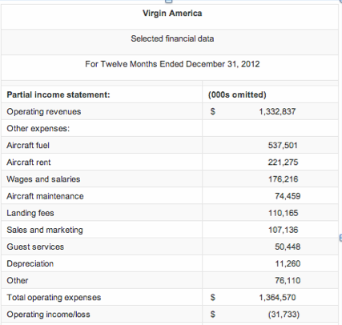

Slide 4
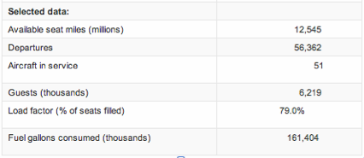

Slide 5
Question 1
For each of the expenses listed in the income statement, select a cost driver from the drivers listed under “Selected data.” Provide rationale for your choice of each of the drivers.

Slide 6
Question 2
Are there any expenses you would group together into a single pool? Why or why not?

Slide 7
Question 3
How could Virgin America use these cost pools and activity-based costing information internally?

Slide 8
Question Recap
For each of the expenses listed in the income statement, select a cost driver from the drivers listed under “Selected data.” Provide rationale for your choice of each of the drivers.
Are there any expenses you would group together into a single pool? Why or why not?
How could Virgin America use these cost pools and activity-based costing information internally?

Slide 9
For additional news stories to use in the accounting classroom, see the Accounting in the Headlines blog at http://accountingintheheadlines.com/
Related video resources can be found at http://www.youtube.com/user/accountingheadlines
Questions or comments? Contact Dr. Wendy Tietz at wtietz@kent.edu

