Slide 1
What were the intangible assets in Yahoo’s purchase of Tumblr?
Original blog posting (August 10, 2013)

Slide 2

Yahoo purchases Tumblr in May 2013 for approximately $990.2 million
Assumed the liabilities which totaled $113.8 million
Yahoo paid approximately $990.2 million
Net value of identifiable assets purchased of $239.4 million

Slide 3
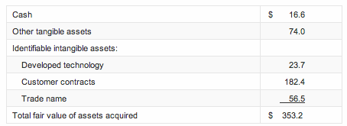
Fair Value of Assets Acquired

Slide 4
Question 1
What amount of goodwill will Yahoo recognize from this transaction?

Slide 5
Question 2
Which intangible assets in the purchase of Tumblr can be amortized by Yahoo?

Slide 6
Question 3
Why would Yahoo be willing to pay $750 million more than the value of Tumblr’s identifiable assets?

Slide 7
Question Recap
What amount of goodwill will Yahoo recognize from this transaction?
Which intangible assets in the purchase of Tumblr can be amortized by Yahoo?
Why would Yahoo be willing to pay $750 million more than the value of Tumblr’s identifiable assets?

Slide 8
For additional news stories to use in the accounting classroom, see the Accounting in the Headlines blog at http://accountingintheheadlines.com/
Related video resources can be found at http://www.youtube.com/user/accountingheadlines
Questions or comments? Contact Dr. Wendy Tietz at wtietz@kent.edu

